Slide 1
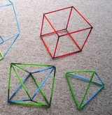
Straw Structures
A collaborative project

Slide 2
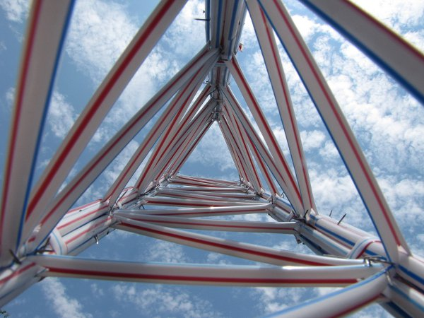
Straw Structures: What the project is
Use the materials given to build a creative structure.
Describe what is creative about your structure
Reflect on how you work in a collaborative group.

Slide 3
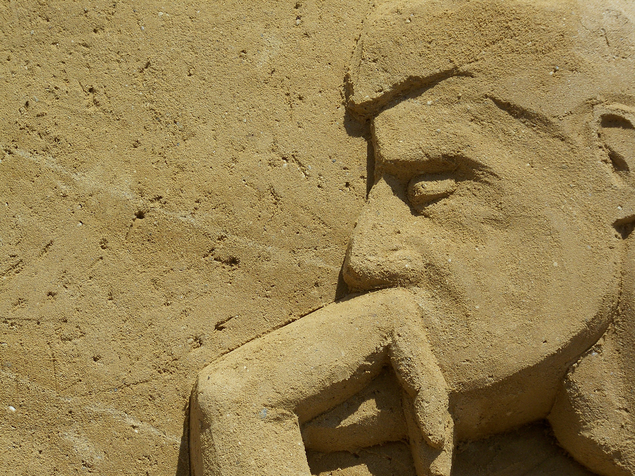
Metacognition
Knowing whether you know an answer or not.
Knowing why you do what you do
Thinking about the choices you make and why you make them.

Slide 4
Metacognition
2 parts to metacognition:
Reflection — thinking about what we know and do
Self-regulation — noticing and managing how we go about learning.
Why do you feel the way you feel? Why do you do things the way you do?

Slide 5
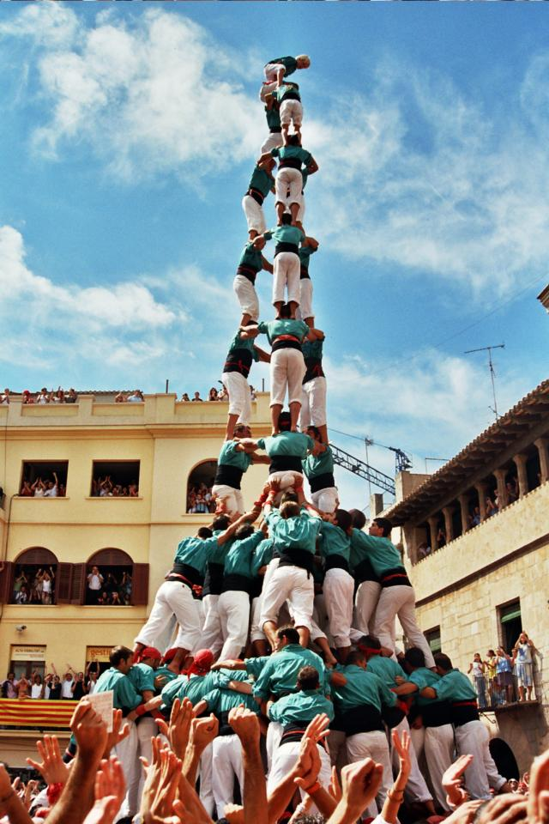
Purpose of this project
Use a design process to design and build something creative
Collaborate, communicate and make decisions as part of a group
Evaluate your strengths in creative designing
Use metacognition and notice when you are contributing productively, adding to group dynamics and helping others to do the same or not.
https://en.wikipedia.org/wiki/Collaboration
https://pixabay.com/en/business-collaboration-cooperation-1296627/

Slide 6
Design Process
Copy this into your brain book
Identify the problem
Brainstorm
Design
Build, test, evaluate, and redesign
Share solutions.
http://pbs.panda-prod.cdn.s3.amazonaws.com/media/assets/wgbh/adptech12/adptech12_int_idsprocess/index.html

Slide 7
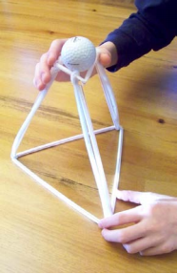
Rubric: 20 points
Point Value | Description
8 | Structure uses at least 20 straws and paperclips in a creative way.
4 | Describe at least 5 reasons why this is a creative structure.
4 | The structure is neatly disassembled at the end of the activity.
4 | Each team member fills in a reflection sheet.
TOTAL | 20 points

Slide 8
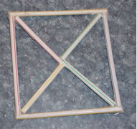
The reflection sheet (example)
What is it? A windowpane
How can it be used? What is its function? Put a bunch together to make a window.
What is creative about your design? A basic building block that can be part of anything
Advantages of this design: very easy to make, symmetric, strong design
Disadvantages: not enough straws, too basic.
Your Name: Mrs O-C
Your sketch of a design idea:
Notes:
This isn’t a good design because it’s way too basic, not really as structure, just part of a structure.

Slide 9
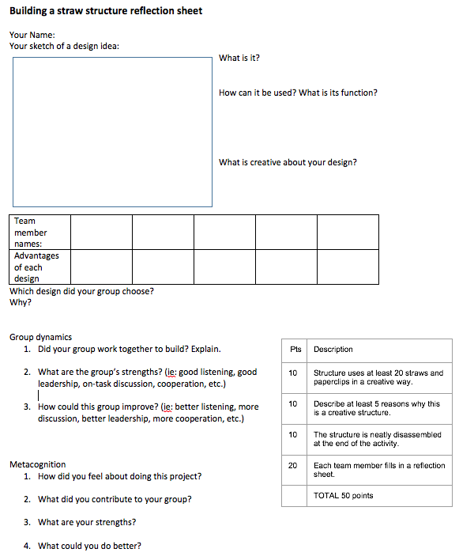
Fill out the reflection sheet
Pts | Description
10 | Structure uses at least 20 straws and paperclips in a creative way.
10 | Describe at least 5 reasons why this is a creative structure.
10 | The structure is neatly disassembled at the end of the activity.
20 | Each team member fills in a reflection sheet.
 | TOTAL 50 points

